Slide 1
Computer Networks
Khizar Mukhtiar
Department of Computer Science
National University of Computer & Emerging Sciences

Slide 2
Recap
Application Layer

Slide 3
Transport Layer

Slide 4
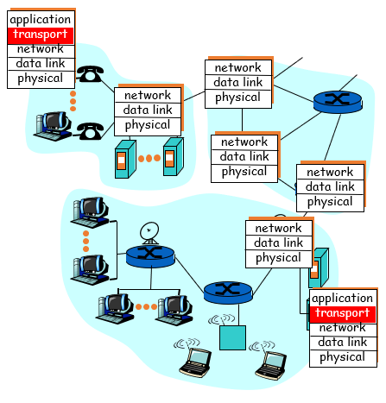
Transport Layer
The Transport layer is a true end-to-end layer, all the way from the source to the destination, providing a logical connection.
Layer 4 of the OSI model, also known as the transport layer, manages network traffic between hosts and end systems to ensure complete data transfers.
logical end-end transport

Slide 5
Transport Layer
While both the data link and transport layers perform some similar functions, such as flow control, error detection, and retransmission, their scope and focus differ:
  Data Link Layer: Provides node-to-node (hop-by-hop) services over a single local link or network segment.
  Transport Layer: Provides end-to-end (process-to-process) services across an entire internetwork of multiple interconnected networks.
Functions of Transport Layer
  Service Point Addressing
  Connection Control
  Segmentation and Reassembling
  Flow Control
  Error Control
  Congestion Control

Slide 6
Service Point Addressing

Slide 7
Service Point Addressing
Process-to-Process Delivery: Because computers run multiple programs simultaneously, delivery requires reaching a specific program (process), not just the destination host.
Service-Point Addressing: The network layer delivers packets to the correct host, while the transport layer uses port numbers (service-point addresses) to route messages to the exact receiving process.

Slide 8
Connection Control

Slide 9
Connection Control
Connection Oriented Transport Layer Protocol:
  A connection-oriented transport layer protocol makes a connection with the transport layer at the destination machine first before delivering the packets
  After all the data are transferred, the connection is terminated
Connectionless Transport Layer Protocol:
  Each segment is considered as an independent packet and delivered to the transport layer at the destination machine

Slide 10
Transport Layer Protocols
Role of IP (Network Layer): IP handles best-effort addressing, packet structure, and routing across host computers, but it does not guarantee delivery or manage how transportation takes place.
Role of the Transport Layer: Sits above IP to handle end-to-end host communication and manage reliability based on application needs.
Two Main Protocols:
  UDP (Connectionless): Prioritizes speed and low overhead over reliability for applications that tolerate minor packet loss.
  TCP (Connection-Oriented): Guarantees reliable, ordered delivery and error handling for applications that require high accuracy.

Slide 11
UDP

Slide 12
User Datagram Protocol (UDP)
The User Datagram Protocol (UDP) is called a connectionless and unreliable transport protocol.
Delivery and duplication control is not guaranteed
UDP is a very simple protocol using minimum overhead.
If a process wants to send a small message and does not care much about reliability, it can use UDP.

Slide 13
UDP Features
UDP is a lightweight transport protocol that offers the same data segmentation and reassembly as TCP, but without TCP reliability and flow control.
UDP features include the following:
  Data is reconstructed in the order that it is received
  Any segments that are lost are not resent
  There is no session establishment
  The sender is not informed about resource availability

Slide 14
UDP Operation
Connectionless Services
  UDP provides a connectionless service.
  Each datagram sent by UDP is an independent datagram.
  There is no relationship between the different user datagrams.
  The user datagrams are not numbered.
Flow and Error Control
  UDP is an unreliable transport protocol
  There is no flow control
  There is no error control mechanism in UDP except for the 16-bit checksum

Slide 15
UDP Structure
UDP is a stateless protocol, meaning neither the client, nor the server, tracks the state of the communication session.
If reliability is required when using UDP, it must be handled by the application
The blocks of communication in UDP are called datagrams, or segments
The UDP header has only four fields and requires 8 bytes (i.e., 64 bits).

Slide 16
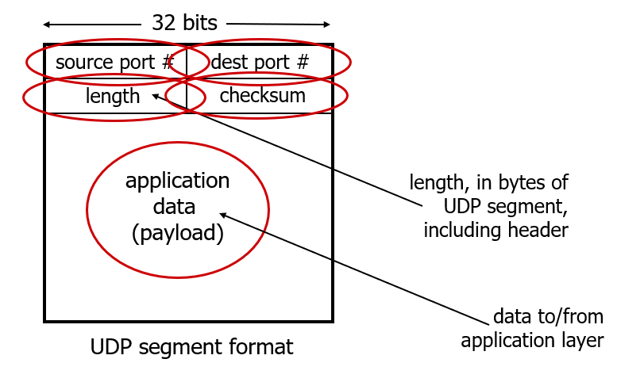
UDP Structure

Slide 17

UDP Checksum
Detect errors (i.e., flipped bits) in transmitted segment
1st number
2nd number
sum
Transmitted: 5 6 11
Received: 4 6 11
receiver-computed
checksum
=
sender-computed
checksum (as received)

Slide 18
UDP Checksum
Sender:
treat contents of UDP segment (including UDP header fields and IP addresses) as sequence of 16-bit integers
checksum: addition (one’s complement sum) of segment content
checksum value put into UDP checksum field
Receiver:
compute checksum of received segment
check if computed checksum equals checksum field value:
  Not equal - error detected
  Equal - no error detected. But maybe errors nonetheless?

Slide 19
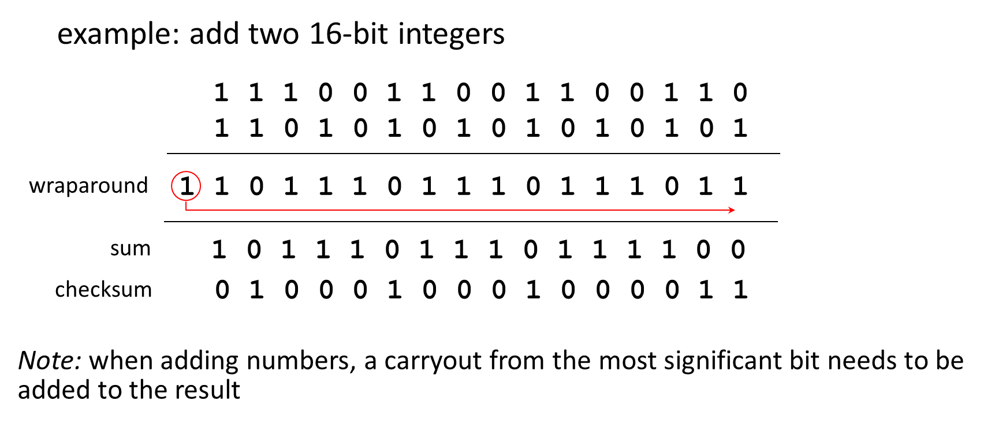
Internet Checksum Example

Slide 20
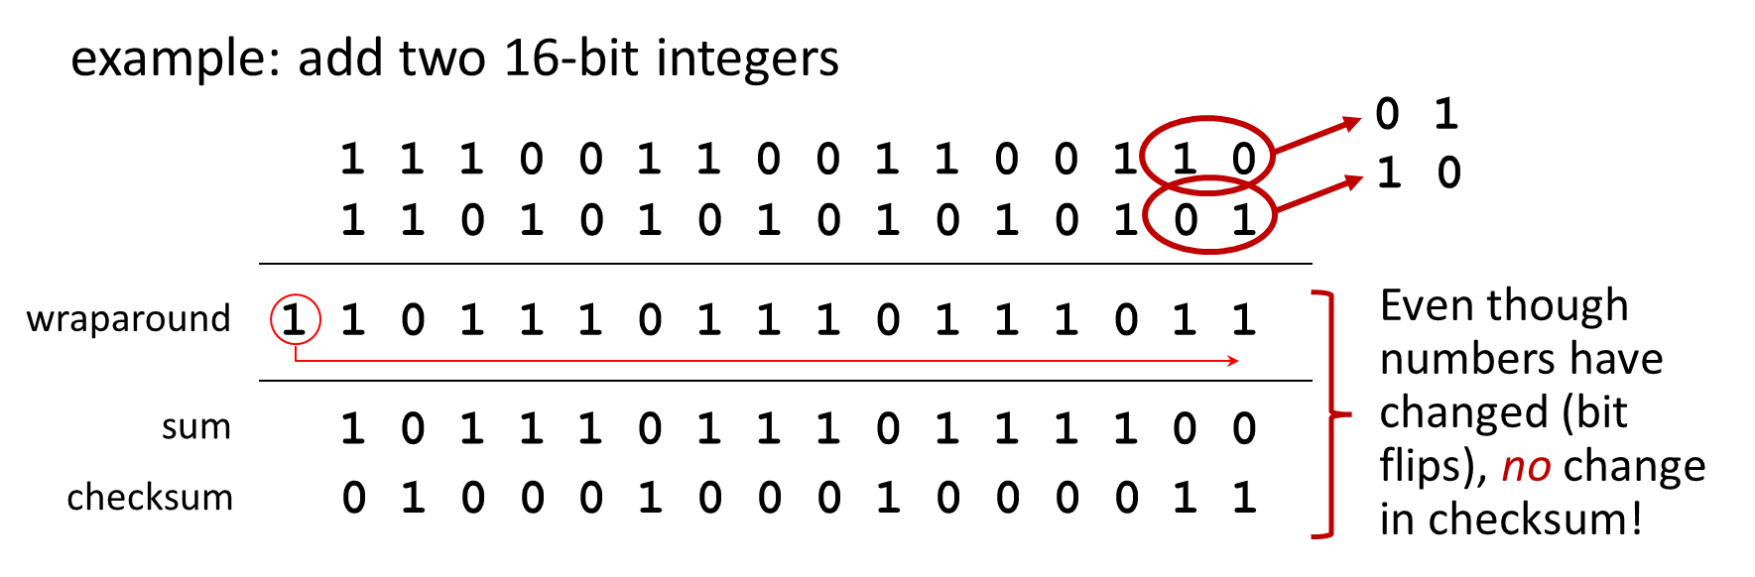
Internet Checksum: Weak Integrity

Slide 21
Applications that use UDP
There are three types of applications that are best suited for UDP:
  Live Video & Multimedia: Applications that tolerate minor data loss but demand real-time performance with minimal delay (e.g., VoIP, live streaming).
  Simple Request/Reply: Lightweight transaction protocols where a host sends a request expecting a fast, minimal response (e.g., DNS, DHCP).
  Self-Reliant Applications: Systems that do not require network-level error recovery or choose to handle reliability within the application itself (e.g., SNMP, TFTP).

Slide 22
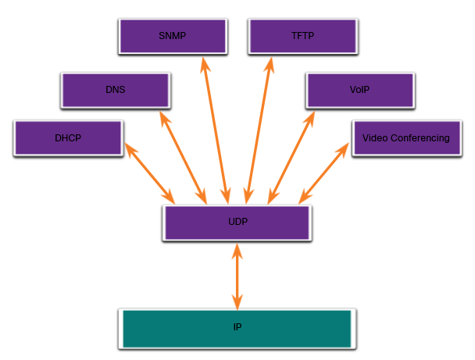
Applications that use UDP
Although DNS and SNMP use UDP by default, both can also use TCP.
DNS will use TCP if the DNS request or DNS response is more than 512 bytes

Slide 23
QUIZ

Slide 24
Calculating the UDP Checksum for a DNS Query
A client sends a minimal DNS query over UDP to resolve a domain name. To ensure data integrity, the network stack must calculate a 16-bit Internet Checksum.
The payload and header fields are broken down into three 16-bit binary words as follows:
  Word 1 (UDP Header fields): 1100 0000 1010 1000
  Word 2 (DNS Header ID): 0111 1100 0000 1101
  Word 3 (DNS Query Payload): 1010 0101 1111 0000
Calculate the final checksum
Explain briefly how the receiving DNS server verifies that no bits were corrupted during transmission using this calculated checksum.

Slide 25
Computer Networks
Khizar Mukhtiar
Department of Computer Science
National University of Computer & Emerging Sciences

Slide 26
Recap
UDP

Slide 27


Slide 28
Reliable Data Transfer

Slide 29
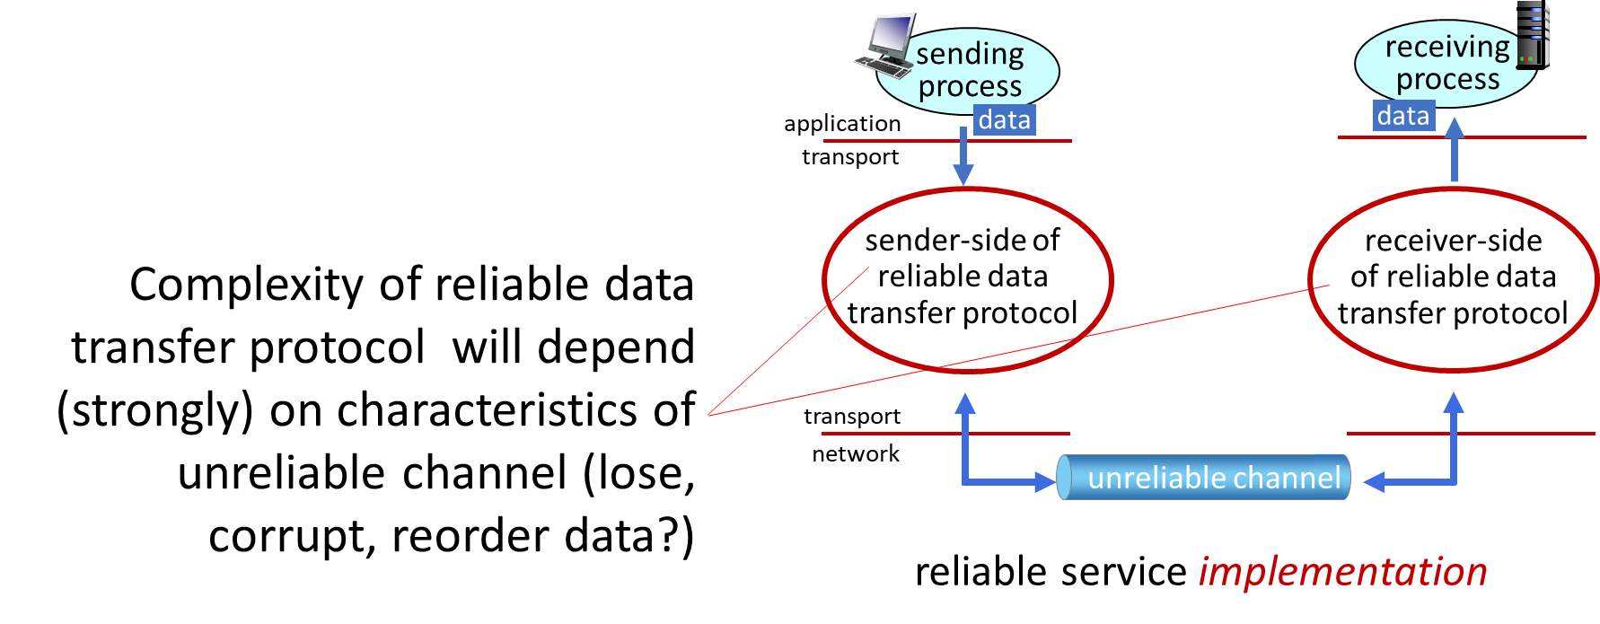
Principles of Reliable Data Transfer

Slide 30
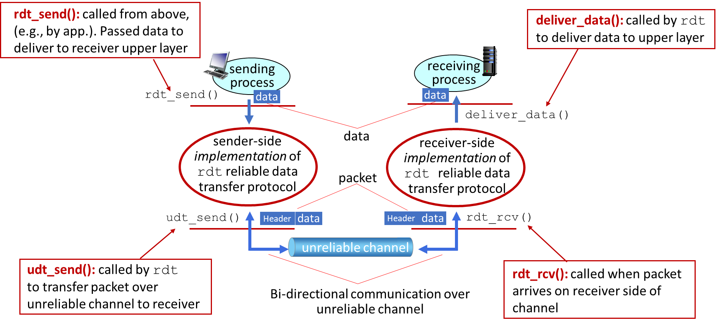
Interfaces of a reliable data transfer protocol

Slide 31
Reliability in a Channel with Bit Errors
Underlying channel may flip bits in packet
  checksum to detect bit errors
The question: how to recover from errors?
  acknowledgements: receiver explicitly tells sender that pkt received OK
  negative acknowledgements: receiver explicitly tells sender that pkt had errors
  sender retransmits pkt on receiving a negative acknowledgement
stop and wait protocol
sender sends one packet, then waits for receiver response

Slide 32
#2
#1
Receiver
Sender
1
2
3
1
2
3
#3
Sender
request
#6
1
2
3
Receiver
1
2
3
#4
request
#5
1
2
1
Note: “state” of receiver (did the receiver get my message correctly?) isn’t known to sender unless somehow communicated from receiver to sender
that’s why we need a protocol!

Slide 33
Issue with this Protocol
what happens if an acknowledgement corrupted?
sender doesn’t know what happened at receiver!
can’t just retransmit: possible duplicate
handling duplicates:
sender retransmits current pkt if an acknowledgement is corrupted
sender adds sequence number to each pkt
receiver discards (doesn’t deliver up) duplicate pkt

Slide 34
Handling Corrupted Acknowledgements
Sender:
seq # added to pkt
two seq. #s (0,1) will suffice.
must check if received ACK/NAK is corrupted
twice as many states
  state must “remember” whether “expected” pkt should have seq # of 0 or 1
Receiver:
must check if received packet is duplicate
  state indicates whether 0 or 1 is the expected pkt seq #
note: receiver can not know if its last ACK/NAK received OK at sender

Slide 35
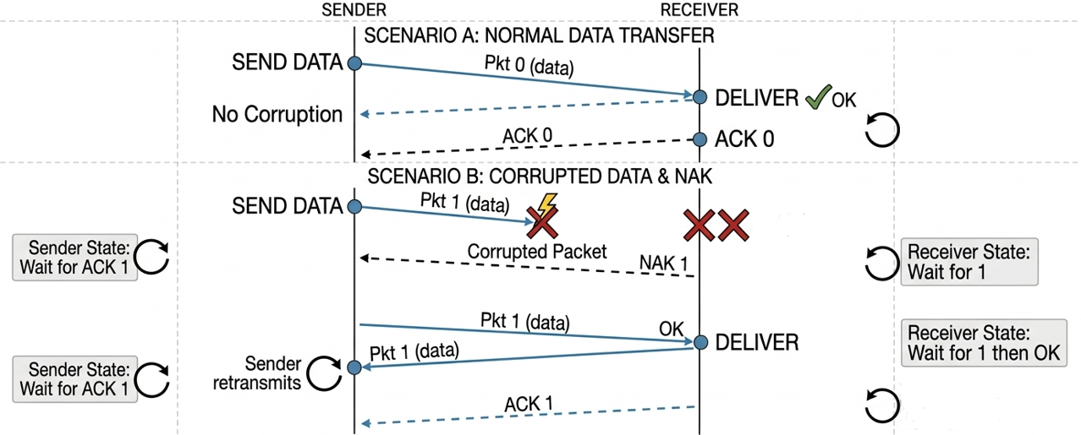
Handling Corrupted Acknowledgements

Slide 36
Handling Corrupted Acknowledgements
Two sequence numbers (0 and 1) suffice in this case because:
  In a Stop-and-Wait protocol, a 1-bit sequence number toggling between 0 and 1 is all the receiver needs to distinguish a brand-new data packet from a duplicate retransmission caused by a corrupted ACK/NAK

Slide 37
Removing Negative Acknowledgements
Same functionality as before, using acknowledgements only
Instead of negative acknowledgement, receiver sends acknowledgement for last pkt received
  receiver must explicitly include seq # of pkt being acknowledged
Duplicate acknowledgement at sender results in same action as negative acknowledgement: retransmit current pkt

Slide 38
Channels with Errors and Loss
New channel assumption: underlying channel can also lose packets (data, ACKs)
  checksum, seq. #, ACKs, retransmissions will be of help … but not enough
Approach: sender waits “reasonable” amount of time for ACK
retransmits if no ACK received in this time
if pkt (or ACK) just delayed (not lost):
  retransmission will be duplicate, but seq. #s already handles this
  receiver must specify seq # of pkt being ACKed
requires countdown timer

Slide 39

Reliable Data Transfer Protocol
sender
receiver
sender
receiver
send pkt0
pkt0
send pkt0
pkt0
rcv pkt0
rcv pkt0
ack0
send ack0
ack0
send ack0
rcv ack0
rcv ack0
send pkt1
pkt1
send pkt1
pkt1
rcv pkt1
X
ack1
send ack1
loss
rcv ack1
send pkt0
pkt0
rcv pkt0
timeout
resend pkt1
ack0
send ack0
pkt1
rcv pkt1
ack1
send ack1
rcv ack1
send pkt0
pkt0
(a) no loss
rcv pkt0
ack0
send ack0
(b) packet loss

Slide 40

Reliable Data Transfer Protocol
Approach: sender waits “reasonable” amount of time for ACK
retransmits if no ACK received in this time
if pkt (or ACK) just delayed (not lost):
    retransmission will be duplicate, but seq #s already handles this!
    receiver must specify seq # of packet being ACKed
    use countdown timer to interrupt after “reasonable” amount of time
timeout

Slide 41
Stop-and-wait Operation
sender
receiver
first packet bit transmitted, t = 0
first packet bit arrives
RTT
last packet bit arrives, send ACK
ACK arrives, send next
packet, t = RTT + L / R

Slide 42
Stop-and-wait Operation
sender
receiver
L/R
RTT
Performance issues

Slide 43
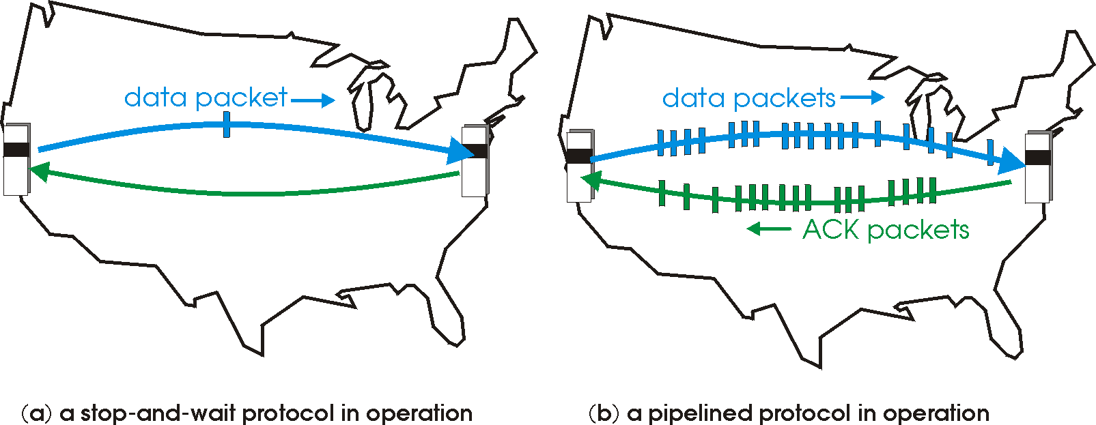

Pipelined Protocols Operation
Pipelining: sender allows multiple, “in-flight”, yet-to-be-acknowledged packets
  range of sequence numbers must be increased
  buffering at sender and/or receiver

Slide 44
Pipelining: Increased Utilization
sender
receiver
first packet bit transmitted, t = 0
last bit transmitted, t = L / R
first packet bit arrives
RTT
last packet bit arrives, send ACK
last bit of 2nd packet arrives, send ACK
last bit of 3rd packet arrives, send ACK
ACK arrives, send next
packet, t = RTT + L / R
Notes:
two generic forms of pipelined protocols: go-Back-N, selective repeat

